Slide 1
Help us help you
Friday, August 05, 2016

Slide 2
66
Total Responses
Date Created: Monday, February 15, 2016
Complete Responses: 53

Slide 3
Q1 & Q2: Name, Company, Function
See separate Word doc

Slide 4
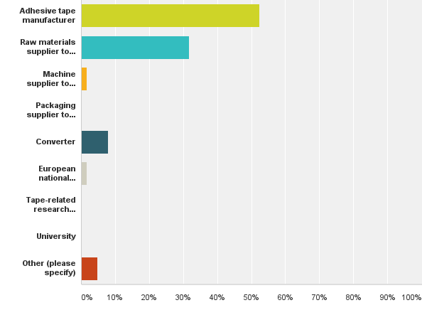
Q3: My organisation is a/an
Answered: 63 Skipped: 3

Slide 5
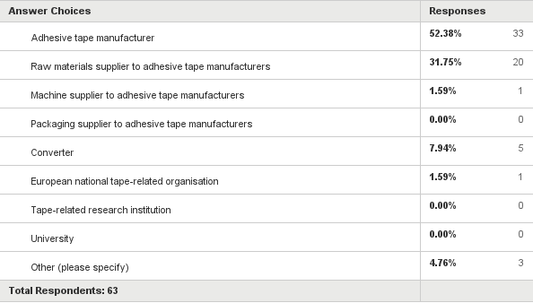
Q3: My organisation is a/an
Answered: 63 Skipped: 3

Slide 6
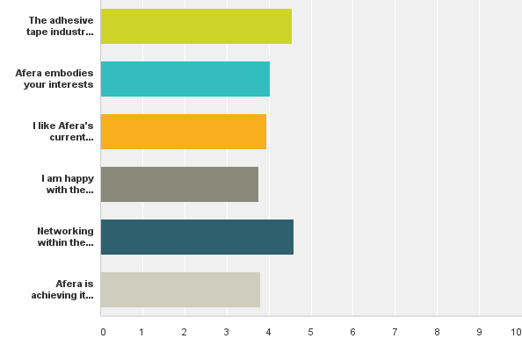
Q4: Please use the following scale to indicate how much you agree with the following statements: 0 (do not agree) - 4 (strongly agree)
Answered: 59 Skipped: 7

Slide 7
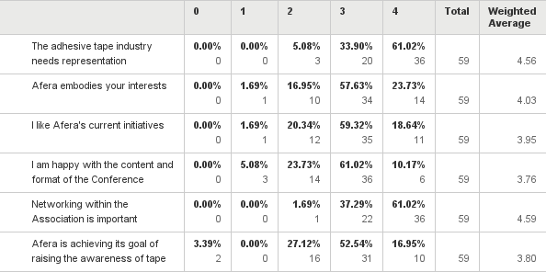
Q4: Please use the following scale to indicate how much you agree with the following statements: 0 (do not agree) - 4 (strongly agree)
Answered: 59 Skipped: 7

Slide 8
Q5: On a scale of 0 to 4 (0 = none, 4 = very much), what value would you place on Afera membership?
Answered: 63 Skipped: 3
0 = 0%
1 = 0%
2 = 6%
3 = 67%
4 = 27%

Slide 9
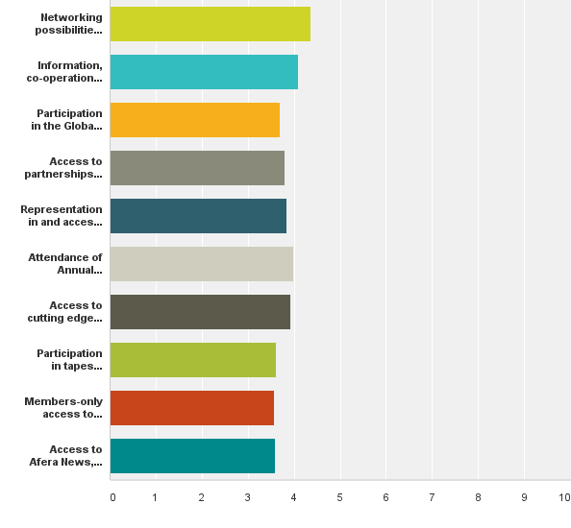
Q6: Why do you feel membership in Afera is important for your organisation?
Answered: 54 Skipped: 12

Slide 10
Q6: Why do you feel membership in Afera is important for your organisation?
Answered: 54 Skipped: 12

Slide 11
Q6: Why do you feel membership in Afera is important for your organisation?
Answered: 54 Skipped: 12

Slide 12
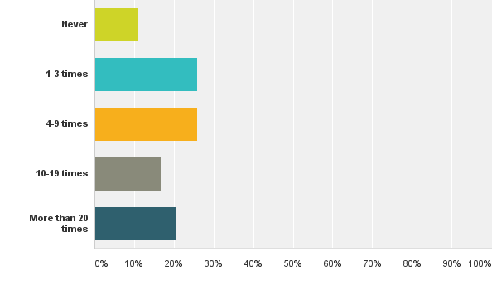
Q7: How many times has someone from your company (who is not on an Afera Committee) attended an Afera event?
Answered: 54 Skipped: 12

Slide 13
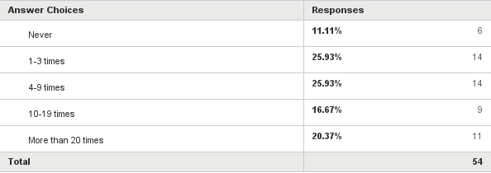
Q7: How many times has someone from your company (who is not on an Afera Committee) attended an Afera event?
Answered: 54 Skipped: 12

Slide 14
Q8: What European country/city is your prefered location for the Annual Conference?
COUNTRIES CITIES
Italy 12x Barcelona 5x
Germany 5x Munich 3x
Spain 3x Amsterdam 3x
Central/South 2x London 3x
France 2x Rome 3x
Portugal, Turkey, Austria, CH, UK 1x Brussels 3x
Cologne 2x
Athens 2x
Frankfurt 2x
Florence, warm location,
Budapest, Brigmingham, Antalya,
Paris all 1x
Remarks: Rotation as now is fine, should be easily reached by plan, international airport closeby

Slide 15
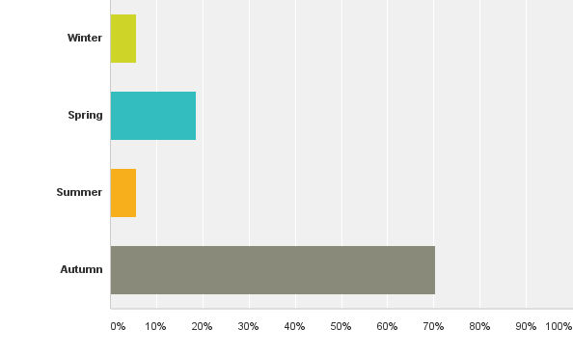
Q9: When would you prefer the Annual Conference to take place?
Answered: 54 Skipped: 12

Slide 16
Q9: When would you prefer the Annual Conference to take place?
Answered: 54 Skipped: 12

Slide 17
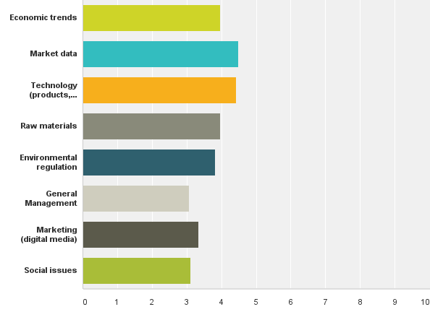
Q10: Please indicate theimportance of topicsyou would most like covered at the Annual Conference:
Answered: 54 Skipped: 12

Slide 18
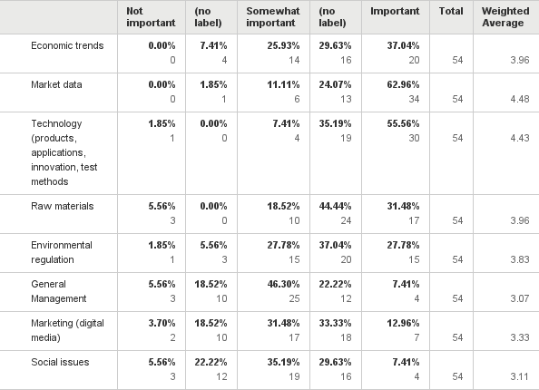
Q10: Please indicate theimportance of topicsyou would most like covered at the Annual Conference:
Answered: 54 Skipped: 12

Slide 19
Q11: Would you be willing to invest time in one of Afera’s Committees?
Answered: 53 Skipped: 13

Slide 20
Q12: On a scale of 0 to 4 (0 = not at all, 4 = highly), how satisfied are you with Afera’s website, afera.com, in terms of content and user-friendliness?
0 0%
1 0%
2 3%
3 54%
3,5 1,5%
4 22,5%
7 1,5%
Skipped question 17,5%

Slide 21
Q13: In your opinion, how could Afera increase its membership value?
Being more strong in standards with Finat for example (Distrex)
Better networking possibilities, Afera should become a Quality guarantee for the products (Volz)
Market contacts (BOMA)
Find Multipliers within the companies who promote Afera (like in our company Evert Smit does) (Lohmann)
Afera should find ways to involve and represent more effectively the packaging tape industry and producers to maintain a central role in the industry (Dow Chemical)
Raw material presentations and information, market data (3M)
Offer a wider perspective of members/participants, covering the full value/supply chain (from raw materials to converters) and pyramid (high end to low end). (Nitto)
Give insights in interesting new technologies/ developments linked to adhesives (e.g. DUS/3D printing case) (Nitto)
Attracting more tape producers to the meetings, giving more precise data on the worldwide sales of tapes and market trends, decreasing also the participation fee to the congress for the tape producers. Often it is a meeting of raw materials suppliers (Ichemco)
it is right now on a high level (IVK)
More aggressive push of tape as technology to tape customers and, moreover, to non-tape users (Coroplast)
By promoting the use of adhesive tapes in as many forums as possible. (Miarco)
More converters (Parafix)
Afera should improve the technical content of the conferences such as PSTC to bring more value to the market (Organik)
Increasing the participation of Tape converters. Then we will have a better networking (Bostik)
1-Enabling strong network within members (tesa)
2-Informing upcoming regulatory issues
3-Creating platforms for penetrating the adhesive tape use in different segments and users
Take a proactive approach to raise AFERA's profile, for example: Have a presence at (large) manufacturing exhibitions and promote the virtues of adhesive tape. (Lohmann)
Parallel the PSTC tape conference (Scapa)
Carry on focusing, in relation to our industry, on topics like technology trends, raw material trends, regulation and social evolution which can affect in the future our industry. I appreciate the topics chosen in latest Afera conferences. (Sicad)
More lobbying in European Associations, More marketing activities and more presence in Social Media, More technical education for tapes (tesa)
More tape manufacturers could participate. (BASF)
More information on market data, global trends (outside of Europe) (Trocellen)
More public relation for the association (Consultant)
Get more involvement from OEMs / users (Automotive, electronics, building & construction etc.) (Ashland)
Afera should mostly lean on technical issues related with adhesive tapes such as preperation of MSDS, TDS, test conditions, regulatory affairs, etc with some present sampling documents to help us to prepare such documents for end users. (Süper Film)
1. qualified market data (Certoplast)
2. development of technique
3. development of countries
Trying to get more people to talk and share ideas. maybe a more interactive session could trigger the minds of the members (How to do it? Difficult! I think just review and try ideas). (Arizona)
Providing more Information in direction of tape user industry (Coroplast)
Invite big tape end-users to the conference like Automobile OEM's or big Players from the electronic market. (Mondi)
We are happy with Afera's present performance. (VITO Irmen)
Better market research data and tools to assist the industry (Atlas)
Initiation and coordination of exchange of topics within the supply chain (supplier, manufacturer, end user) (Artimelt)
Hosting events in conjunction with regional associations (Organik)

Slide 22
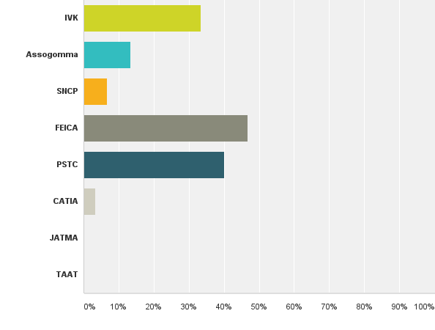
Q14: Which other industry (or related) associations are you a member of?
Answered: 30 Skipped: 36

Slide 23
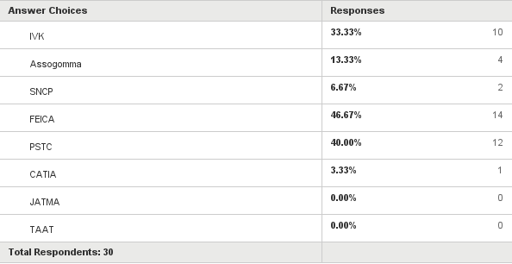
Q14: Which other industry (or related) associations are you a member of?
Answered: 30 Skipped: 36

Slide 24
Q15: Additional comments
To become a member in one of the committees it would be interesting to know how much work this will be. We are a afera member since one year and are interested to become a committee member but we need to know more about it. (Volz)
Overall I believe AFERA is doing a nice job, bringing together key players of the adhesive tape industry and giving insights in new evolutions.(Nitto)
The yearly membership fee of 2.200,- Euro is quite high.(Nippon)
Good Initiative...The more outside-in view we can get to improve AFERA the better (tesa)
Afera is on a good track with strong global impact.
More good market data for annual conference are needed. Question is: how to obtain it.
Afera should help us to solve some quality issues during production of adhesive tapes by technical committe and/or some consulting based organizations. (Süper Film)

Slide 25
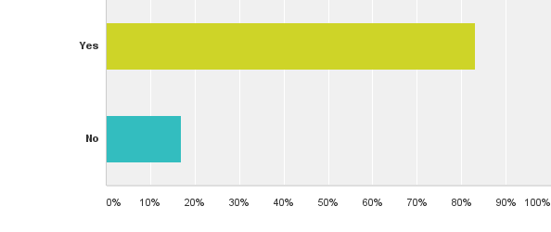
Q16: Would you allow us to contact you to discuss your point of view?
Answered: 53 Skipped: 13

Slide 26
Q16: Would you allow us to contact you to discuss your point of view?
Answered: 53 Skipped: 13

